Slide 1

Bogor Traffic Monitoring Dashboard
Data Analyst Mini Project
DSLS 2023
Author : Ihsan Nur Faqih

Slide 2
Contents
Business Understanding
Data Understanding
Dashboard Feature and Use Case

Slide 3
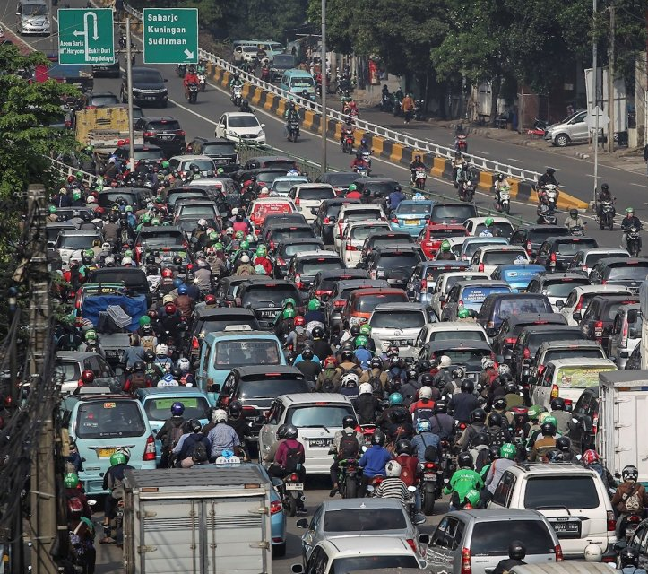
Business Understanding
Traffic jam is one of the biggest problem in Indonesia, particularly in Jabodetabek
According to Worldbank, Indonesia lost 56 Trillion IDR/year due to traffic jams
“Managing traffic using real time monitoring to prevent traffic jam with deploying more Police Officer or Traffic Warden to area can be solution for the Mayor of Bogor”

Slide 4
Solution Proposed
Using real time monitoring traffic data and weather data, Bogor City Government can manage traffic by deploying more Police Officer or Traffic Warden to relieve traffic jams

Slide 5
Contents
Business Understanding
Data Understanding
Dashboard Feature and Use Case

Slide 6
Data Understanding
To deliver solution, data gathered from several sources:
Traffic data gathered from Waze
Weather data gathered from OpenWeather

Slide 7
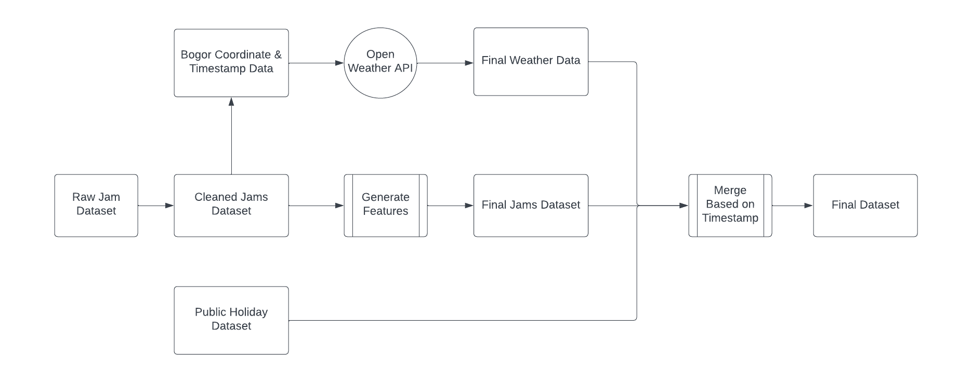
Data Understanding
Dataset Preprocessing

Slide 8
Contents
Business Understanding
Data Understanding
Dashboard Feature and Use Case

Slide 9
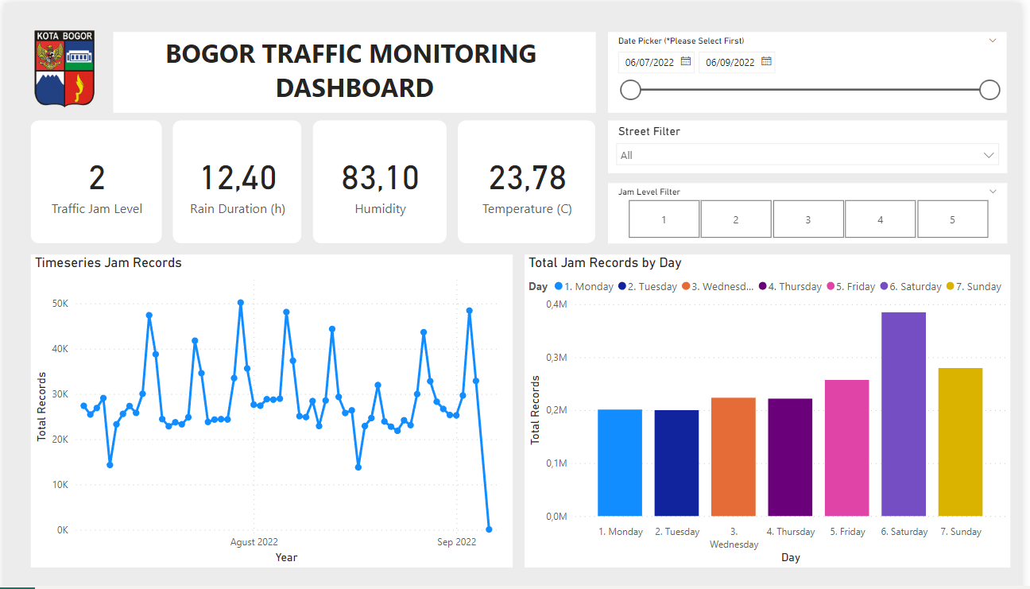
Dashboard Feature & Use Case
Part 1
1
2
3
4

Slide 10
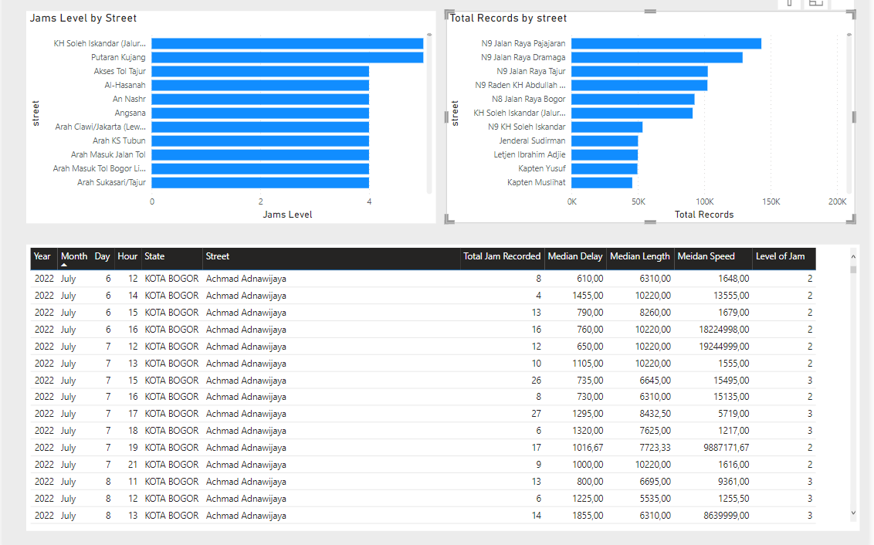
Dashboard Feature & Use Case
Part 2
5
6
7

Slide 11
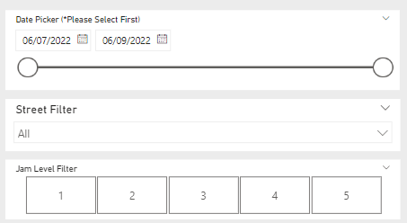
Dashboard Feature & Use Case : Detail
1. Filtering Section
In filtering section, user can filter based on Date, Street Name, Jam Level.
Reasoning :
User can filter date to tracing historical data about traffic jam in Bogor city
Street name filter will make user easily focusing to deeper dive in specific street name, especially for street name that mainly have high traffic such as Dramaga, Pajajaran, etc.
Jam level filter will make user easily focusing on which street that need fast resolve to handle traffic, to deploy Traffic Warden or Police Officer

Slide 12
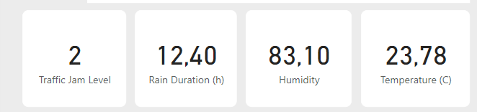
Dashboard Feature & Use Case : Details
2. Scorecard Section
Scorecard section showing 4 information, Median Traffic Jam level (0 is lowest and 5 is highest), rain duration (if weather is in rain), humidity, and average temperature of the day in Celsius.
Main reason for traffic jam level scorecard is to maintain traffic jam level as lowest as possible, if the traffic jam level increase to 3, 4, or 5. Government can take action as quick as possible to relieve the traffic
Weather condition information is show for helping user prepare for rain that cause traffic, or rain possibility in the City.

Slide 13
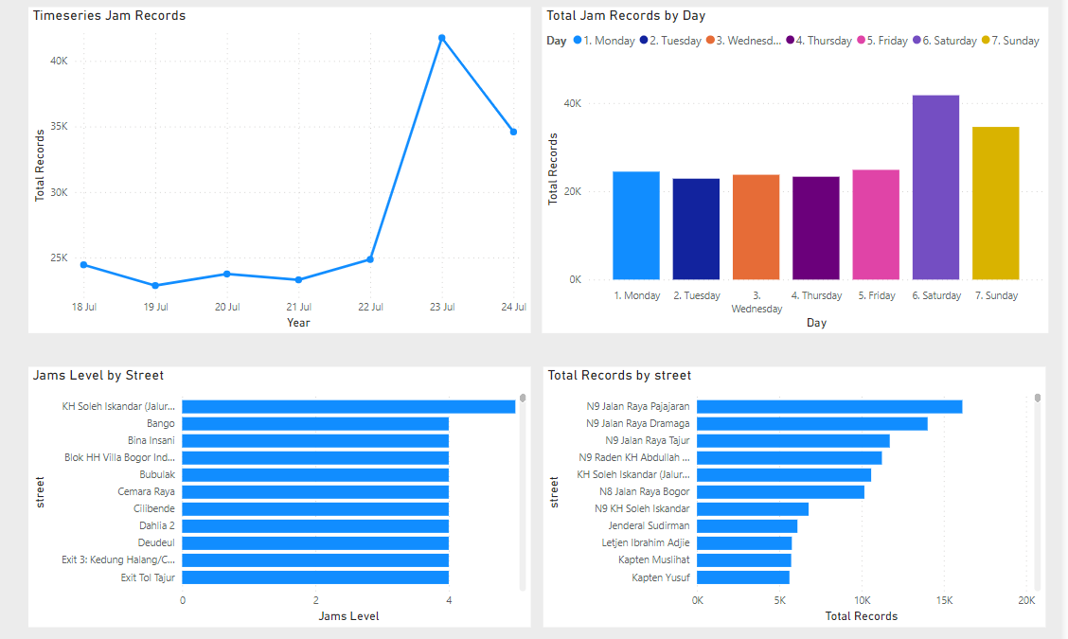
Dashboard Feature & Use Case : Detail
3. Main Dashboard Section (3,4,5,6)
For this use case, the data already filtered in 1 week time span, we can gather information on time series chart that 27 July is the peak traffic of the week, and from the right side we can inference that it’s happened on Saturday. Street that have heavily traffic is KH Soleh Iskandar, and total records submitted happened in Jalan Raya Pajajaran, for other use case please click on chart since it’s very interactive

Slide 14
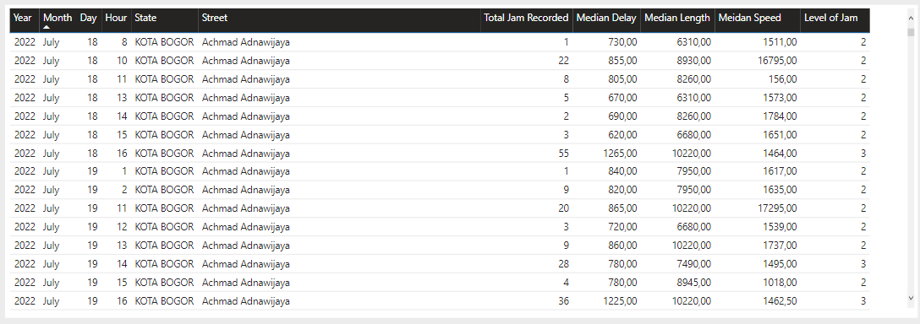
Dashboard Feature & Use Case : Details
3. Main Dashboard Section (7)
In this section will show a table for detail record in case user want to know the detail of visualized data

Slide 15
Dashboard Feature & Use Case : Goals
All the metrics selected including traffic condition, total jam recorded, level of jam and current weather condition have 1 goals
“To help governance take action as quick as possible to deploy resources (traffic warden, police officer, etc.s) on highly traffic street moreover if governance know where the traffic happened, then policy can be made to tackle traffic, such as : Odd-Even Rule or Paid Road Implementation”

